Slide 1
SoK : Can NFTs Solve The Economic Problems of Countries with Ancient Heritage? Egypt as a Case Study
Shymaa M. Arafat
shymaa.arafat@gmail.com, shar.academic@gmail.com

Slide 2
Motive
Why don't debted countries make money from Cryptocurrencies & DeFi ???
Notes:
A lot of voices around the world, and papers also, discussed the question how can developing countries made money from Cryptocurrencies? The current circulating Bitcoin and Ethereum worth value can pay some countries all debt

Slide 3
Agenda
Countries & Cryptocurrencies
NFT usages in arts & donations
NFTs & Metaverses in museums and cultural
Egypt case
Challenges & Design Decisions
NFT developers view.
Conclusions
Notes:
To answer this question, a scan of as much as possible of all online and literature material was to needed to produce this taxonomy about the subject, and I will give you a brief on all the of the following topics

Slide 4
Other countries Experiences
Mining
Banning ➡️ China, Malysia
(Fear of ransomware, criminal activities, Ponzi schemes, energy consumption, carbon footprint)
Notes:
Let's explore what other countries have done -The first thought was mining, between social mediavoices and some reports about Monero mining (alt coin to Bitcoin, but with more secrecy), we only have an explicit statement from Worth Texas mining Bitcoin . -Then repulsive Banning Ethiopia, China after hosting major mining pools (but still having an NFT-Metaverse project), Malaysia published a seen of destroying $1.5 bn worth of mining devices . -Fears: Effect on fiat currency, ransomware & criminal activities due to anonymity (sometimes opposition fund, recall human rights grant to Utreexo) +Electricity consumption & environment criticisms

Slide 5
Other countries Experiences
Bitcoin Adoption ➡️ Selvador
Problems
»»»Advantage
Notes:
-Countries adopted Bitcoin as main currency Venezuela, West Africa, ..., let's talk about the most recent experiment on Salvador . -Problems in Network readiness (errors), people willing (just used the incentive startup money), affected by last price drops. . NO NO, that's all too risky & also volatile, we do not want to suggest that . -one Benefit: Adding youth tourists who only use crypto money. »»»Yes we could use that

Slide 6
Motive ...
NFT world trading volume is billions
(source)
Metaverse is 68 billions
(source)
Notes:
Then, what about NFTs? & there role in games & Metaverses???? If Governments collected money through NFTs & Metaverses that's not risky and doesn't include all of these problems... And we can make it eco-friendly

Slide 7

Where is Egypt (1/3 world ancient heritage) share of this Pie???
Notes:
-Don't we have 1/3 of world ancient heritages? -Don't we have ancient civilizations with a lot of fancy legends to tell & use in games? don't we have artists who can create suspense in that? -Don't we also have rare coral reefs in Red Sea that we can use in a lovely Metaverse, and also archive before deterioration?

Slide 8
Notes:
Don't we also have both previous & new trials of online & VR tourism to have the intuition to do it???

Slide 9
NFTs in arts & Celeberties (Entertainment Business)
Games
Beeple pic
Musicians
(Fans clubs, tickets, advantages,..., royalties)
Johnney Deb
(Event driven)
Notes:
-NFTs started with Games like Cryptopunks & crypto kitties ( earlier trials with Bitcoin colored coins or skins didn't continue) -We all heard about Beeple pic., a chance to young/infamous art creator, just like YouTube and other platforms introduced a chance to talented show creators -Artists, celebrities got the idea and went with the flow quickly since they're used to commercial uses of selling their posters, digital records; handling social media & digital environments in general -NFTs evolved to add benefits to buyers like tickets discounts, exclusive lives with the celebrity,... & also royalties to the creator to get a ratio of each resell. -Events, scoops, or whatever attracts the media was used to example johnny deb

Slide 10
NFTs Cultural & Community
Yale University
UN
US Bill of Rights
Museums joined the club
The point is museums don’t sell anything, they just grant the use of the image

Slide 11
Table of musuems in order
Notes:
I guess before Metaverse all museums NFTs summary table

Slide 12
Metaverses added Extra Merits
Fashion brands NFTs
➡️ could join with ancient Royal Jewelries
Joint International Metaverse projects
Learn to Earn Concept
Morpheus project

Slide 13
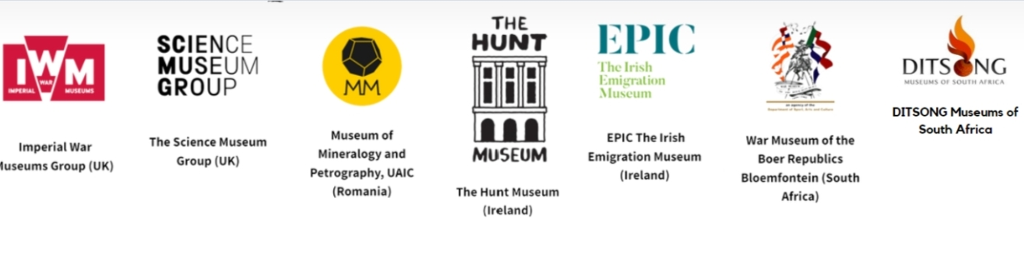

The Morpheus Project

Slide 14
Other Countries Big Investments
South Korea ($200m)
UAE ($54m)
China
Italy DAWs ➡️
Notes:
Countries with heavy investments include South Korea, UAE, China in Shanghai in spite of the crypto banning . -Before I go to next point, let me brief you about DAWs as a some what different and very expensive 3D NFTs that need to be connected to a Computer -The advantages of Tours ( different than the physical object, provide more, & could be used for mummies in Egypt provides better than true object) -Problems of cost happened in Italy

Slide 15
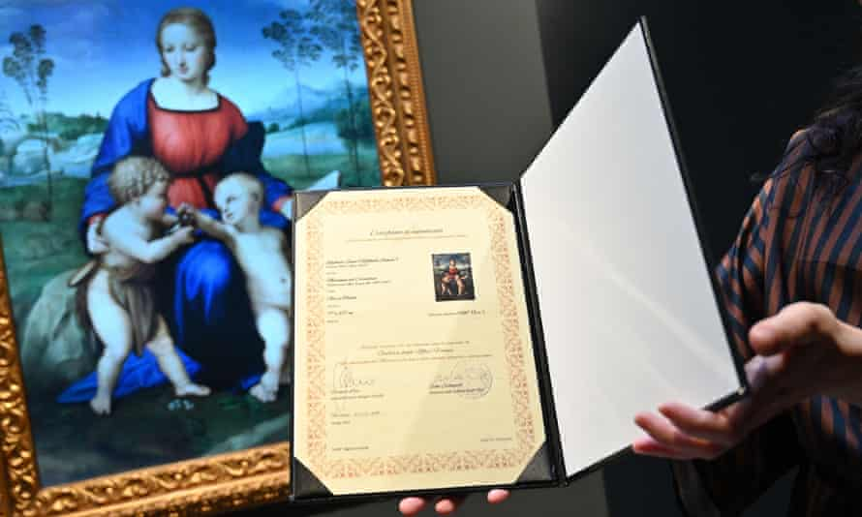
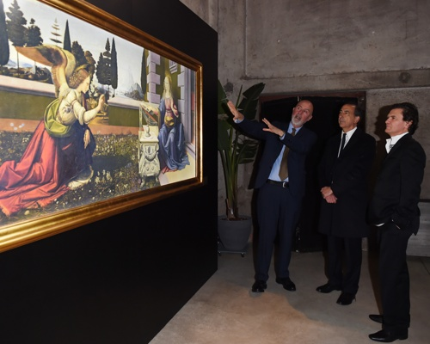
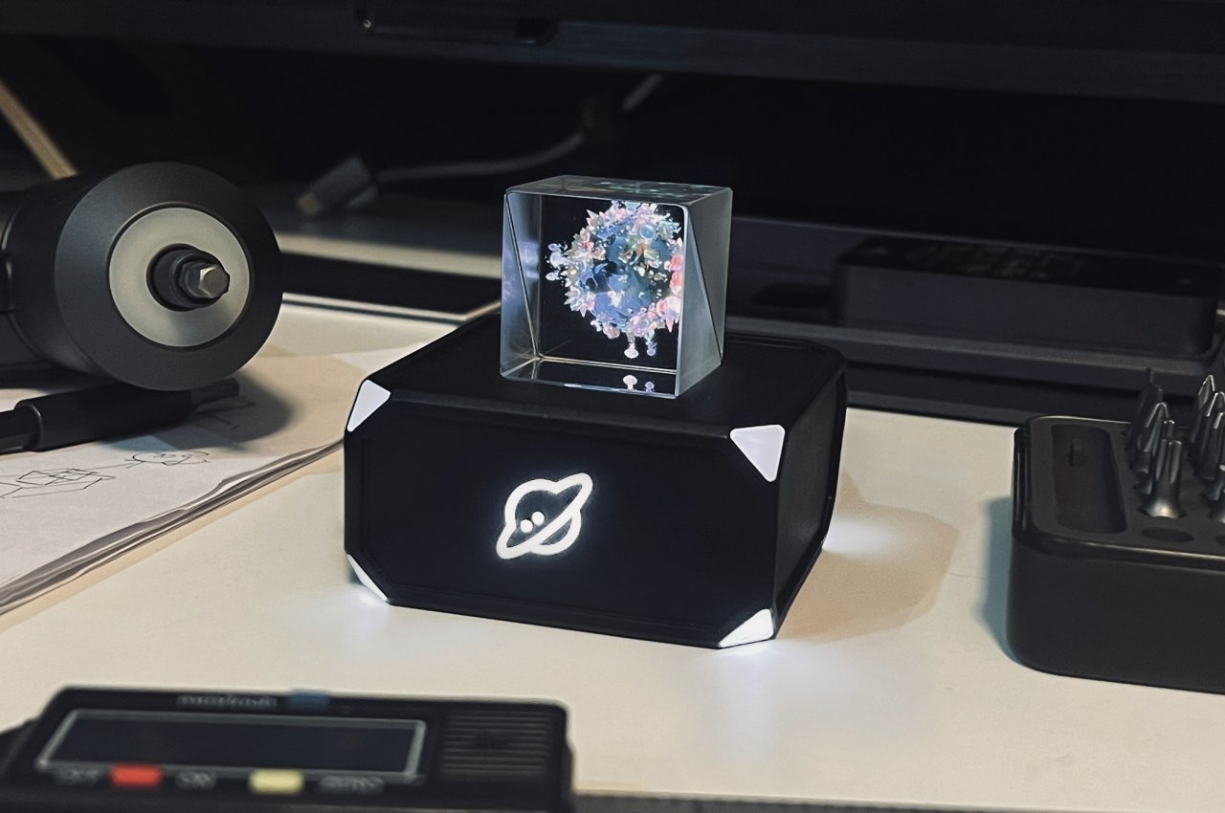
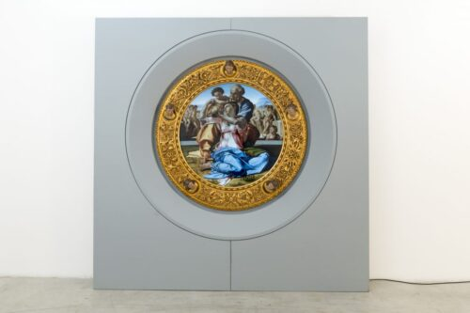
What are DAWs? Why halted in Italy?
Notes:
-Italy found that the museum took only 1/3 of the selling price (80,000$ from 240,000$) -DAWs from Cinello are not just regular NFTs, they're only minted to the Blockchain on customer request to add more authenticity . -Profit & revenue from exhibition tours without bringing the physical painting (Saudi Arabia, then London)

Slide 16
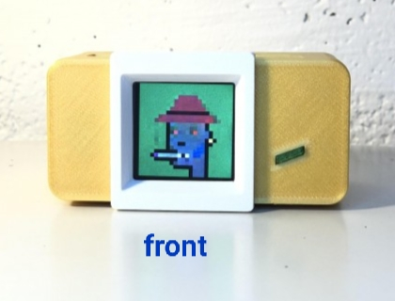
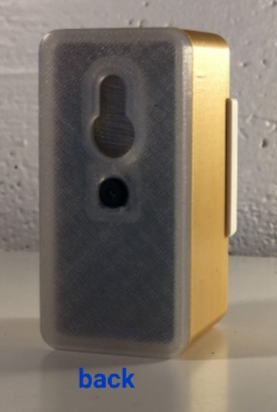
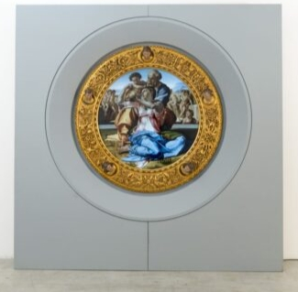
NFT viewing hardware
a Doni Tondo DAW®
From Uffizi
3D Holographic
Notes:
-There are special NFT viewing hardware devices, 2D & 3D

Slide 17
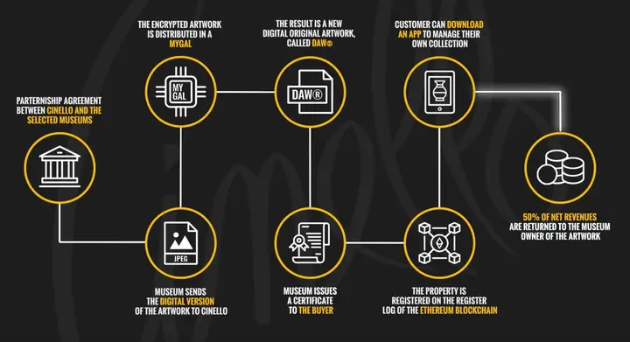
What are DAWs? Why halted in Italy?
Notes:
-Italy found that the museum took only 1/3 of the selling price (80,000$ from 240,000$) -DAWs from Cinello are not just regular NFTs, they're only minted to the Blockchain on customer request to add more authenticity . -Profit & revenue from exhibition tours without bringing the physical painting (Saudi Arabia, then London) . Ethereum Blockchain is used

Slide 18
Key Issues ...
Notes:
All the challenges involved in the process & design decisions that we have to consider

Slide 19
Challenges & Key Issues (Choices?)
Network readiness. ✔️ ✅ ☑️
Human Resources. ✔️ ✅ ☑️
Economics, Analysis of risk & return
Notes:
-We don't have to worry about all network problems happened in countries like Salvador, since our target customers are tourists around the world that will use their internet facilities most of the time not ours. -There are developers (graduates /yr), artists, applied arts, economists, lawyers ( I'll discuss copyrights after a couple of slides) -We have previous & current VR projects. -Any needed training will add to the human resources value; or network facilities in the same sense. . -Now let's move to the Blockchain choice

Slide 20
Economics
NFTs are volatile & subject to FOMO
Why not seize the opportunity?
Bring tourism metrics to the formula

Slide 21
Economics
Free drops, moderate prices, expensive DAWs
Market clearance, fairness, geo-distribution
Royalties as a feedback, not just downstream sell ratio
Notes:
-Economists should study market metrics & make their analysis regarding: 1-What to sell as expensive DAWs, what in moderate price, what in cheap, what and when to offer free drops 2-The number of each also to achieve market clearance, sense of fairness, and maybe Geo-distribution ( like what countries are more fond of Egypt, or what countries are harder to physically come due to distance or any other factors) >>>> Vitalik post, a16z group ( after getting market metrics, this falls in game theory research) . -Finally, use royalty to get extra profit + to trace selling patterns statistics and analyze them

Slide 22
Blockchain Choice
Ethereum created NFTs
Criticisms for environmental damage
Favors POS vs POW
(Tezos, Solana, Cardano, Ethereum L2 POS)
Algorand : no cryptocurrency ➡️un-forkable
Make your own Blockchain

Slide 23
Security & Privacy
Metaverses have the same VR /AR/XR vulnerabilities
Meta Guard new research data obfusication
NFT attacks

Slide 24
NFT Data Storage
The NFT verifying ownership (authentication) is stored on the Blockchaim, but where is the actual digital image physically stored???

Slide 25
NFT Data Storage Options
Clouds: centralized, Amazon CloudFront
IPFS: decentralized, problems
Side Blockchains
Arweave
FileCoin
StateSnap

Slide 26
Copyrights

Slide 27
Liabilities & Regulations

Slide 28
NFTs Developers view

